Slide 1
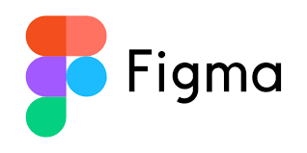
3-Days Workshop on
Kapil Dev Pant
Nast College

Slide 2
Final Outcomes For Students
Confidence in using Figma
Understanding of UI/UX basics
Portfolio-ready project
Team collaboration experience

Slide 3
TO-DO list
DAY 1: UI/UX and Figma (BASICS)
Introduction to UX UI.
Introduction to Figma
Basic Design tools
Layout and Alignments
Components and Variants
DAY 2: Auto Layouts, Prototyping And Collaboration(INTERMEDIATE)
Auto Layout
UX Principles and User Flow
Prototyping and Interactions
Collaboration, Handoffs and Best Practices
Assignment
Design Competition
Preparing For competition

Slide 4
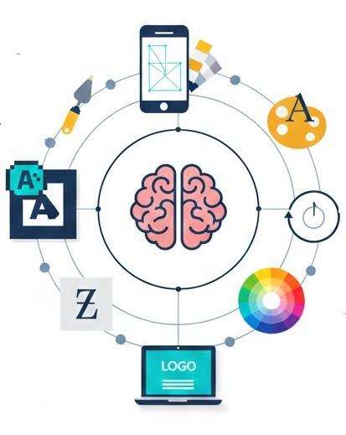
What is Graphic Design?
Visual Communication
Branding & Identity
Web & App Design
Print & Design Media
Typography
Problem Solving
Visual Hierarchy
Color
Notes:
Graphic design is the art and practice of planning and creating visual content to communicate messages, ideas, or information effectively using typography, imagery, color, layout, and visual hierarchy.

Slide 5

What IS UI & UX ?

Slide 6
What is UI and UX ?
How a product looks and feels
UI is all about the visual and interactive elements of a product what the user sees and touches.
UI Includes
Buttons, icons, menus
Colors, fonts, spacing
Layout of screens/pages
Animations and transitions
Forms, sliders, toggles
How a product works and how it feels to use
UX focuses on the overall experience a user has while using a product from start to finish.
UX Includes :
User research and user needs
Information architecture (how content is organized)
User flows (steps to complete a task)
Usability and accessibility
Error handling and feedback
User satisfaction
Notes:
Goal of UI: Make the product attractive, consistent, and easy to interact with.
Example:
In a mobile app:
The color of the “Login” button
Font size of text
Icon style (flat, 3D, outline)
Placement of navigation bar
Goal of UX: Make the product useful, usable, and satisfying.
Example:
In the same mobile app:
Is login fast and simple?
Can users find features easily?
Are error messages clear?
Does the app feel smooth or frustrating?

Slide 7
UI/UX in real World
Improves User Satisfaction
Saves Time and Effort
Reduces Errors and Mistakes
Increases Business Success
Builds Trust and Credibility
Improves Accessibility & Inclusivity
Reduces Training and Support Costs
Notes:
1. Improves User Satisfaction
Good UI makes products visually pleasant.
Good UX makes tasks easy and stress-free.
Real world example:
A banking app with clear buttons and simple steps makes users feel confident.
Confusing design causes frustration and mistakes.
Happy users = loyal users
2. Saves Time and Effort
Well-designed UX reduces unnecessary steps.
Clear UI helps users understand actions instantly.
Example:
Online ticket booking:
Good UX → Book ticket in 2–3 minutes
Bad UX → Users quit halfway
Time-saving design is critical in today’s fast life.
3. Reduces Errors and Mistakes
Proper UI (labels, colors, spacing) prevents wrong clicks.
Thoughtful UX avoids confusion and wrong decisions.
Example:
ATM machines:
Clear “Cancel” and “Confirm” buttons
Warning messages before final transaction
In healthcare, aviation, and banking, bad UX can be dangerous.
4. Increases Business Success
Better UX → More users complete actions
Better UI → Higher trust and professionalism
Example:
E-commerce websites:
Good UX → More purchases
Bad UX → Cart abandonment
UI/UX directly affects revenue.
5. Builds Trust and Credibility
Clean UI makes products look reliable.
Smooth UX makes users feel safe.
Example:
Government portals:
Clear instructions = trust
Poor design = users doubt authenticity
People judge credibility within seconds.
6. Improves Accessibility & Inclusivity
Good UX considers:
Elderly users
Visually impaired users
First-time users
Example:
Large text, voice support, simple flows
Multilingual interfaces (important in real-world societies)
Good UI/UX = design for everyone
7. Reduces Training and Support Costs
Easy-to-use systems require less training.
Fewer helpdesk calls and complaints.
Example:
Office software or hospital systems
Employees learn faster if UX is intuitive
Companies save money long-term.
8. Encourages Adoption of Technology
People resist complex systems.
Good UX makes new technology acceptable.
Example:
Digital payments:
Simple UI helped mass adoption
Complex systems failed despite powerful features
UX decides success of innovation.

Slide 8
Design Thinking
Empathize
Define
Ideate
Prototype
Test
What problems are
users facing?
More Ideas = More Solutions
Show prototype to users
and get feedback
Why design is bad ?
Visual of how final
system will loot
Notes:
Empathize: Understand Users their problems Emotions and needs
Define: convert user insights into a clear problem statement.
Ideate: think of all possible solutions that can be approached.
Prototype:
Create a simple version of solution
Design wireframe or UI screen,
Create clickable prototype
Prototype != final design
Design thinking= understand users, - define problem, create ideas, design solution, test and improve

Slide 9
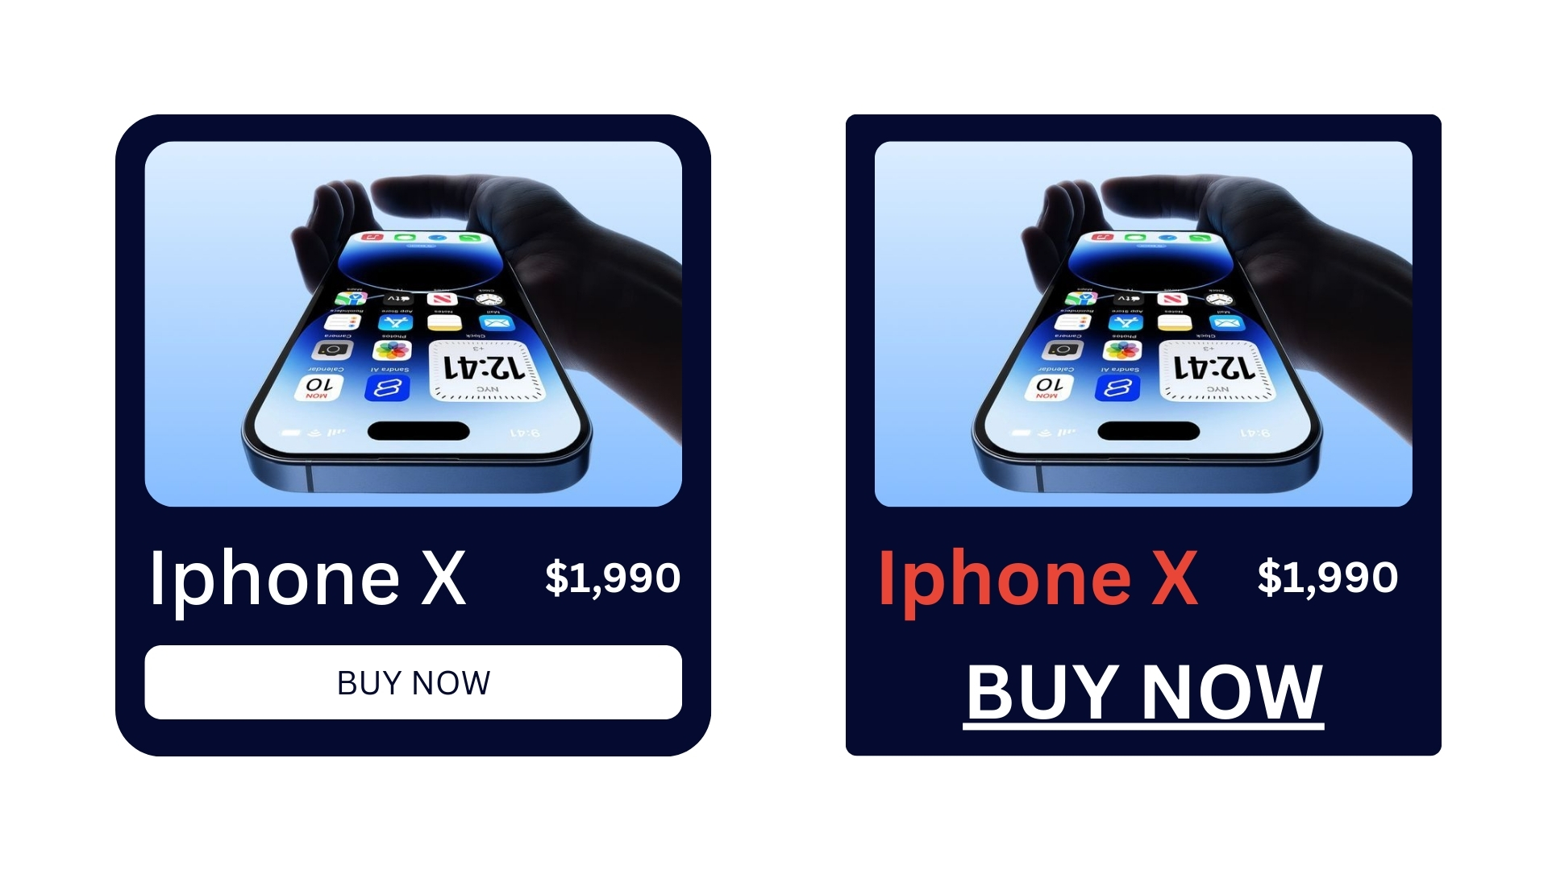
Good UI VS bad UI

Slide 10
How to know Good UI and Bad UI ?
Visual Clarity & Simplicity
Consistency
Visual Hierarchy
Readability & Typography
Color Usage & Contrast
Feedback & System Response
Navigation & Discoverability
Responsiveness & Adaptability
Error Prevention & Recovery
Notes:
1️⃣ Visual Clarity & Simplicity
✅ Good UI
Clean, uncluttered layout
Clear purpose on every screen
Only necessary elements are shown
User immediately knows what to do next
📱 Example: Google Search – one input box, one action.
❌ Bad UI
Too many buttons, texts, pop-ups
No clear hierarchy
User feels overwhelmed
📱 Example: Old government portals with 10 links, banners, and ads on the homepage.
2️⃣ Consistency
✅ Good UI
Same colors, fonts, button styles throughout
Same action = same behavior everywhere
Icons mean the same thing across screens
🎯 Why it matters: Users don’t have to “re-learn” the interface.
❌ Bad UI
Different button colors for same action
Fonts change randomly
Same icon performs different tasks
🚨 Result: Confusion + mistakes.
3️⃣ Visual Hierarchy
✅ Good UI
Important things stand out
Uses size, color, spacing, contrast
User’s eyes naturally flow top → bottom
👀 Example:
Big heading
Medium subheading
Small body text
Primary button highlighted
❌ Bad UI
Everything looks equally important
No emphasis
User doesn’t know where to look first
4️⃣ Readability & Typography
✅ Good UI
Easy-to-read fonts
Proper font size (especially for mobile)
Good line spacing and contrast
📖 Example: Medium, Notion, Apple interfaces
❌ Bad UI
Fancy fonts that hurt readability
Very small text
Low contrast (light gray text on white background)
5️⃣ Color Usage & Contrast
✅ Good UI
Limited color palette
Colors have meaning (red = danger, green = success)
Good contrast for accessibility
🎨 Example: WhatsApp: green for actions, gray for secondary info
❌ Bad UI
Too many bright colors
No contrast
Colors used only for decoration
🚫 Accessibility nightmare.
6️⃣ Feedback & System Response
✅ Good UI
Shows feedback for every action
Loading indicators
Success / error messages
🔄 Example: Button shows loading spinner after click.
❌ Bad UI
Click button → nothing happens
No error explanation
User wonders: “Did it work?”
7️⃣ Navigation & Discoverability
✅ Good UI
Easy to find features
Logical menu structure
Familiar patterns (hamburger menu, tabs)
🧭 Example: Instagram bottom navigation.
❌ Bad UI
Hidden important features
Confusing menus
Non-standard navigation without explanation
8️⃣ Responsiveness & Adaptability
✅ Good UI
Works well on all screen sizes
Touch-friendly buttons
No horizontal scrolling on mobile
📱💻 Example: Modern e-commerce websites.
❌ Bad UI
Desktop UI forced on mobile
Tiny buttons
Elements overlap
9️⃣ Error Prevention & Recovery
✅ Good UI
Prevents mistakes
Clear error messages
Easy undo or correction
✔ Example: “Are you sure you want to delete?”
❌ Bad UI
Allows dangerous actions easily
Vague errors: “Something went wrong”
No way to recover
🔟 Accessibility (Often Ignored, Very Important)
✅ Good UI
Keyboard-friendly
Screen-reader support
Color-blind safe
🌍 Good UI is inclusive UI.
❌ Bad UI
Color-only indicators
No labels
Impossible for disabled users

Slide 11
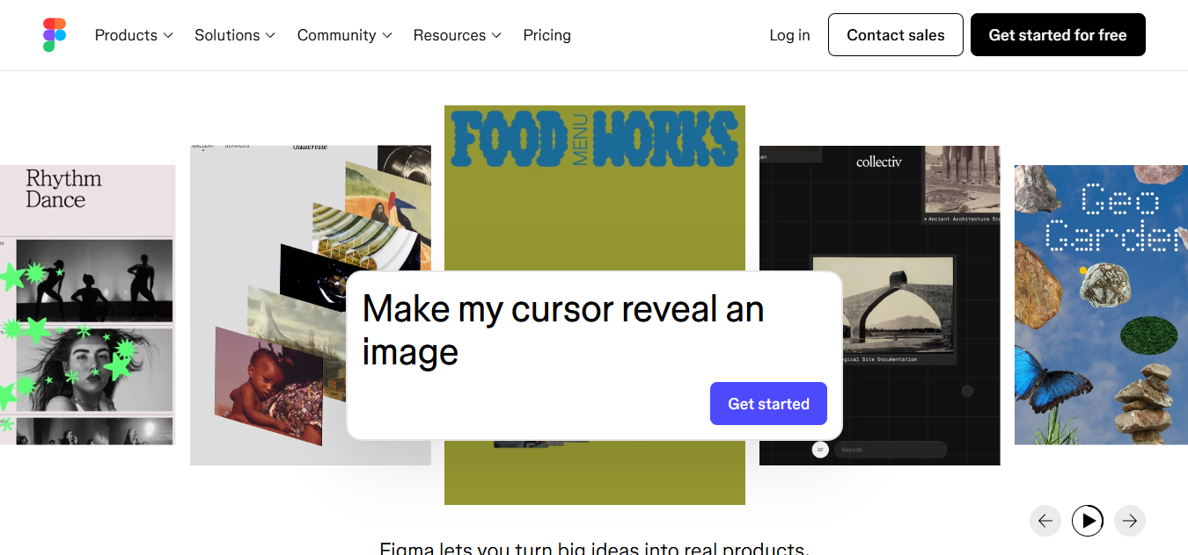
What is Figma ?

Slide 12
What is Figma ?
Cloud-based UI/UX design and prototyping
Google Docs for design
Industry Standard
UI Screens
Prototype
Startups
Designers
Reusable Components
Developers
Collaborate
Stakeholders
Review Design
Notes:
Figma is a cloud-based UI/UX design and prototyping tool used to design websites, mobile apps, dashboards, and digital products
Figma is like Google Docs for design, where multiple people can design and edit the same UI at the same time.
allows designers, developers, and stakeholders to design, prototype, collaborate, and review designs in real time all in one place
What can you do with Figma?
Design UI screens (mobile, web, dashboard)
Create interactive prototypes
Build reusable components (Design Systems)
Collaborate live with team members
Share designs via link (no installation needed)
Comment and give feedback directly on designs
Handoff designs to developers (CSS, spacing, assets)

Slide 13
Why Industry Standard?
Real-Time Collaboration
Cloud-Based (No Heavy Software Needed)
Strong UI + UX + Prototyping in One Tool
Easy Design-to-Development Handoff
Design Systems & Components Support
Free & Accessible for Students and Beginners
Massive Industry Adoption
Notes:
Why is Figma Considered an Industry Standard?
Figma is called an industry standard because it solves real-world problems faced by design and development teams.
1. Real-Time Collaboration (Biggest Reason)
Multiple designers can work at the same time
Developers, managers, and clients can view designs live
Changes are visible instantly
Real-world impact:
Faster design reviews
No “send updated file” problem
Perfect for remote and hybrid teams
This single feature replaced many older tools.
2. Cloud-Based (No Heavy Software Needed)
Runs in browser
Works on Windows, macOS, Linux
Auto-save and version history
Why industry loves this:
No version confusion (final_v3_revised.fig )
Easy access from anywhere
3. Strong UI + UX + Prototyping in One Tool
Older tools needed:
One tool for design
One for prototyping
One for collaboration
Figma does everything in one platform:
UI design
UX flow
Interactive prototype
Feedback & comments
Saves time and cost.
4. Easy Design-to-Development Handoff
Developers can:
Inspect designs
Get CSS / spacing / colors
Download assets
Check responsive behavior
Result:
Fewer misunderstandings
Faster implementation
Better final product
That’s why developers also prefer Figma.
5. Design Systems & Components Support
Reusable components (buttons, cards, navbars)
Auto-update everywhere
Consistency across products
Used by:
Google
Microsoft
Meta
Startups and enterprises
Essential for large-scale real products.
6. Free & Accessible for Students and Beginners
Free plan is powerful
No cracked software culture
Easy learning curve
Result:
Used in universities
Taught in workshops
Preferred by freshers
Industry adopts what talent already knows.
7. Massive Industry Adoption
Used by:
UI/UX Designers
Product Designers
Developers
Startups
Enterprises
Integrated with:
Jira
Slack
Notion
GitHub
React / Dev tools
Once the ecosystem accepts a tool, it becomes standard.

Slide 14
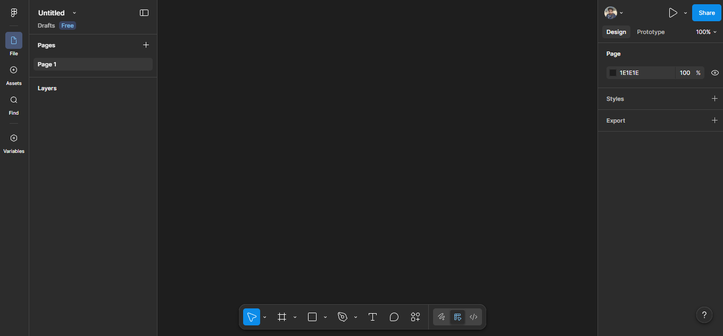
Interface overview
Menu Bar
Properties
Zoom
Navigation
Layer Panel
(CANVAS)
The main design area
Where you create screens, layouts, and prototypes
Tool Bar
Notes:
1. Menu Bar (Top Bar)
Location: Very top of the screen
What it contains:
File options (New, Save, Export)
Edit (Undo, Redo, Preferences)
View (Zoom, Layout grids, Rulers)
Object (Group, Frame, Mask)
Plugins & Widgets
Help & Resources
Importance:
Controls the entire design environment
Access to plugins and settings
2. Toolbar (Top Center)
Location: Below the menu bar
Key tools:
Move tool (V) – Move/select objects
Frame tool (F) – Create frames (screens)
Shape tools – Rectangle, Ellipse, Line, Polygon
Pen tool (P) – Custom vector paths
Text tool (T) – Add text
Hand tool (H) – Pan canvas
Comment tool (C) – Add feedback
Importance:
Used to create and manipulate UI elements
3. Layers Panel (Left Sidebar)
Location: Left side
Shows:
Frames
Groups
Components
Individual layers (text, shapes, icons)
Functions:
Rename layers
Lock / hide layers
Organize design structure
Select specific elements easily
Very important for clean and professional design
6. Assets Panel
Location: Left sidebar (Assets tab)
Contains:
Components
Icons
UI elements
Design system elements
Importance:
Reuse elements
Maintain consistency
Faster design workflow

Slide 15
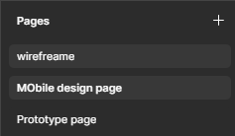
Pages
Pages are top-level sections used to organize and separate different parts of a design project
A page in Figma is like a folder that groups related frames and designs together.
Why are Pages Important?
Without pages:
Designs become messy
Hard to find screens
Confusing for teams
With pages:
Clear workflow
Better collaboration
Easy navigation
Notes:
Common Real-World Use of Pages
1. Wireframes Page
Used for:
Rough layouts
Low-fidelity designs
Early UX thinking
Page name: Wireframes
2. UI Design / Final Design Page
Used for:
High-fidelity screens
Colors, fonts, icons
Final UI
Page name: Final UI
3. Components / Design System Page
Used for:
Buttons
Forms
Icons
Reusable components
Page name: Components
4. Prototypes Page
Used for:
User flows
Clickable screens
Transitions
Page name: Prototype
5. Developer Handoff Page
Used for:
Final approved screens
Clean layouts for developers
Page name: Dev Handoff

Slide 16
Frames (F)
Frames are containers used to design screens or sections of a user interface.
They define the size, layout, and boundaries of a design such as a mobile screen, web page, or dashboard
Notes:
Frames help you:
Design for specific devices (mobile, tablet, desktop)
Organize UI elements properly
Create responsive layouts
Build prototypes and navigation flows
Frames in Prototyping
Each frame = one screen
Used to:
Link screens
Add transitions
Create user flows
Buttons, text, images go inside a frame
Each frame represents one screen or section

Slide 17
Handson:
Create a new Figma file
Create frames for mobile & desktop

Slide 18
Basic Design tools
Shapes & Pen tool
Text tool & typography basics
Colors, gradients, strokes
Images & icons (plugins)

Slide 19
Layout and Alignment
Grid systems
Alignment & spacing
Constraints & resizing

Slide 20
Hands on task
Design a simple mobile login screen

Slide 21
Components
Reusable UI element
Building blocks of your UI system
Design it once
Reuse it every where
Good Practice (Industry Standard)
✔ Keep main components in a separate page
✔ Use clear naming (Button / Primary / Large)
✔ Use variants instead of duplicates
✔ Never detach instances unless necessary
✔ Combine with Auto Layout
Update it once
Changes apply everywhere
Notes:
A switch in your house. You don’t redesign the switch for every room ; you reuse the same design.
Why Components are Important
Consistency across screens
Faster design workflow
Easy updates (change once, reflect everywhere)
Essential for Design Systems
Developers love it (clean handoff)

Slide 22
Types of Components
Main Component (Original Source)
Component Instance
Nested Components
Variants
Interactive Components
Notes:
Types of Components in Figma
1. Main Component
The original source
All changes start here
Usually kept in a Design System / Components page
Icon: Purple diamond
Example: Primary Button (Blue, rounded, white text)
2. Component Instance
A copy of the main component
Used inside frames/screens
Inherits properties from the main component
Icon: Hollow purple diamond
Example: Same button used on Login, Signup, Dashboard screens
3. Nested Components
Components inside other components
Example: Button component contains:
Icon (component)
Text label (component)
Change the icon component → all buttons update
4. Variants (Very Important )
Variants allow multiple states in one component set
Common variant properties:
State → Default / Hover / Pressed / Disabled
Size → Small / Medium / Large
Type → Primary / Secondary / Danger
Example: Button Component:
Primary – Default
Primary – Hover
Secondary – Disabled
All in one place, super clean
Make
Variants (hover, active, disabled)
Buttons, input fields, cards
5. Interactive Components
Components with prototypes inside them
Used for:
Hover effects
Toggle switches
Dropdowns
Button animations
Example: Hover over a button → color changes No need to animate every screen separately
6. Boolean Properties
Turn things ON / OFF
Example:
Icon → Show / Hide
Error message → Visible / Hidden
Very useful for:
Form inputs
Buttons with optional icons
7. Text Properties
Allows changing text in an instance
Example: Same button component:
“Login”
“Submit”
“Pay Now”
Without breaking the component structure
8. Swap Instance (Instance Swap)
Replace one component with another
Example: Swap:
Search icon → Close icon
Light mode icon → Dark mode icon
Used heavily in:
Icon systems
Navigation bars
9. Auto Layout + Components (Power Combo)
Components become responsive
Example:
Button auto-resizes based on text
Card adjusts height automatically
Essential for:
Real-world UI
Mobile & web layouts

Slide 23
Creating Components
Variants (hover, active, disabled)
Buttons, input fields, cards

Slide 24
Day 1 Assignment
Build a clean homepage layout
Design 2–3 screens of a mobile app using components

Slide 25
DAY 2: ADVANCED FIGMA, PROTOTYPING & UX PRACTICES

Slide 26
Auto Layout (Shift + A)
Auto Layout is a layout system in Figma that lets you design responsive, flexible UI components that automatically adjust when:
Text length changes
Items are added/removed
Screen size or container size changes (Hug, Fill. Fixed)
Task: Build a responsive mobile screen using Auto Layout
Notes:
What Auto Layout can do
With Auto Layout, you can control:
Direction: Vertical / Horizontal (Shift + H)
Spacing between items
Padding inside a container
Alignment (left, center, right)
Responsive resizing (Hug, Fill, Fixed)
Common Use Cases
Buttons
Navbars
Forms
Cards
Lists (settings, menus, chat items)
Design systems & reusable components
Resize Type Meaning
Hug contents Size depends on content
Fill container Fills parent space
Fixed Manual size

Slide 27
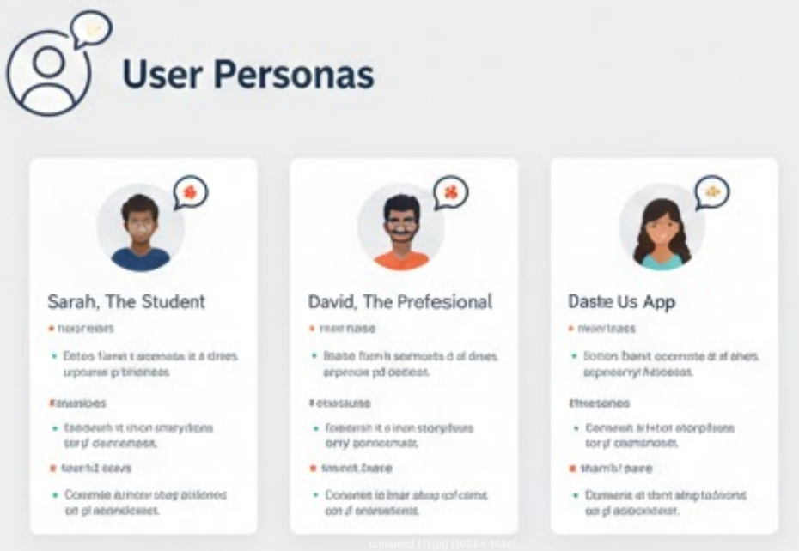
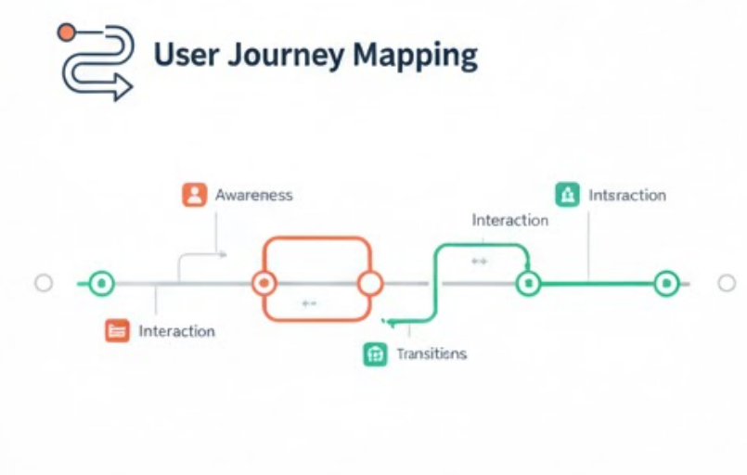
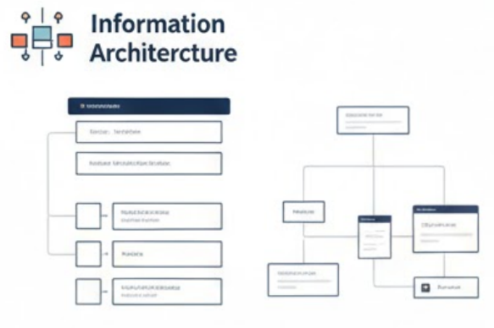
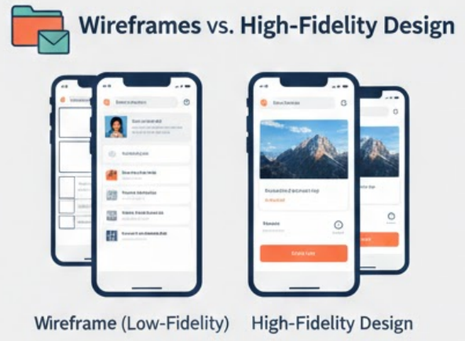
UX Principles & User Flow
User personas
Activity : Create a simple user flow diagram
User journey mapping
Information architecture
Wireframes vs high-fidelity designs
Notes:
User Personas
What is a User Persona?
A User Persona is a fictional but realistic profile representing a target user of your product.
It answers:
Who is the user?
What do they want?
What problems do they face?
How tech-savvy are they?
How User Personas are created in Figma
In Figma, personas are usually:
Frames or cards
Created during the UX research phase
Shared with developers & stakeholders
🔹 Typical Persona Elements
Name & photo
Age, profession
Goals
Pain points
Devices used
Short quote (behavior summary)
📱 Example
Persona: 👤 Kapil, 28, Lecturer
Goal: Teach students
Pain point: Slow learning
Device: Laptop
In Figma → One frame = One persona card
2 User Journey Mapping
What is User Journey Mapping?
A User Journey Map visualizes the step-by-step experience of a user while interacting with a product.
It shows:
User actions
Thoughts
Emotions
Pain points at each step
🔹 Why it matters
Identifies UX problems early
Improves flow and usability
Aligns designers, developers, and stakeholders
🔹 How it looks in Figma
Usually a horizontal flow with stages like:
StageActionEmotionProblemLoginEnter credentials😐OTP delayDashboardView classes🙂Confusing layout
Each column is a frame in Figma.
📱 Example (Attendance App)
Open app
Login
Select subject
Mark attendance
Confirmation
In Figma → Use Auto Layout rows for steps.
Information Architecture (IA) in Figma
🔹 What is Information Architecture?
Information Architecture defines how content is organized, structured, and labeled.
Think of it as:
“Where does everything live?”
🔹 Why IA is important
Reduces confusion
Improves navigation
Makes apps intuitive
🔹 IA in Figma = Structure before design
Usually shown as:
Site maps
Flow diagrams
Tree structures
📂 Example (University App IA)
Home ├── Dashboard ├── Attendance │ ├── Subject List │ └── Attendance History ├── Profile └── Settings
In Figma → Use:
Text + lines
Simple shapes
No colors (UX-first)
4️⃣ Wireframes vs High-Fidelity Designs (in Figma)
🔹 Wireframes (Low Fidelity)
Wireframes show structure only, not visuals.
Characteristics:
Black & white
Boxes, lines, placeholders
Focus on layout & flow
📐 In Figma:
Use rectangles
Default font
No images or colors
📌 Example:
[ Logo ]
[ Input Field ]
[ Button ]
🔹 High-Fidelity Designs
High-fidelity designs look like the final product.
Characteristics:
Colors, fonts, icons
Real images
Branding
Pixel-perfect UI
🎨 In Figma:
Color styles
Components
Auto Layout
Prototypes
Wireframe High-Fidelity
Structure-focused Visual-focused
Fast to create Time-consuming
No branding Full branding
Early UX stage Final UI stage

Slide 28
Prototyping & Interactions
Prototyping modes : Simulate how a product works
Linking screens: connecting using interactive triggers like clicks, hovers, or key presses
Transitions & animations : define how screens move or change during navigation
Overlays & modals : appear on top of the current screen without navigating away
Create an interactive prototype for a mobile app
Notes:
1. Prototyping Modes
What it is
Prototyping mode in Figma allows designers to simulate how a product works by adding interactions between screens—without writing any code.
Figma mainly supports:
Design Mode → create UI
Prototype Mode → define interactions & flow
Best Practices
Prototype only key user flows
Keep interactions simple and realistic
Name frames properly before linking
Test prototype using Present mode
Importance
✔ Helps visualize user experience ✔ Detects usability issues early ✔ Saves development cost ✔ Useful for client demos & user testing
📌 Example: Clicking “Login” shows the dashboard instead of just a static screen.
2. Linking Screens
What it is
Linking screens means connecting one frame to another using interactive triggers like clicks, hovers, or key presses.
How it works in Figma
Select an element (button, icon, card)
Drag the blue node to another frame
Define trigger (On click, On hover, etc.)
Best Practices
Always link primary CTAs (buttons)
Avoid broken links
Follow real navigation logic
Keep consistent navigation patterns
Importance
✔ Creates realistic navigation ✔ Helps stakeholders understand flow ✔ Improves usability testing ✔ Clarifies app structure
📌 Example: “Sign Up” → Registration Screen → OTP Screen → Home Screen
3. Transitions & Animations
What it is
Transitions define how screens move or change during navigation.
Common Transition Types
Instant
Dissolve
Slide in / Slide out
Push
Smart Animate
Best Practices
Use Smart Animate for smooth motion
Keep animations short (200–400ms)
Avoid excessive effects
Match animation with user action
Importance
✔ Improves user experience ✔ Makes interfaces feel responsive ✔ Guides user attention ✔ Makes product feel modern
📌 Example: A card smoothly expands into a detailed view using Smart Animate.
4. Overlays & Modals
What it is
Overlays are UI elements that appear on top of the current screen without navigating away.
Common Examples
Login popup
Alert box
Confirmation dialog
Bottom sheets
Dropdown menus
How it works in Figma
Set interaction → Open overlay
Choose position (center, top, bottom)
Enable background click to close
Best Practices
Use overlays only for important actions
Keep content minimal
Always provide a close option
Avoid stacking too many overlays
Importance
✔ Maintains context ✔ Reduces navigation complexity ✔ Improves focus on important actions ✔ Common in real-world apps
📌 Example: “Delete Account” → Confirmation modal appears instead of a new screen.

Slide 29
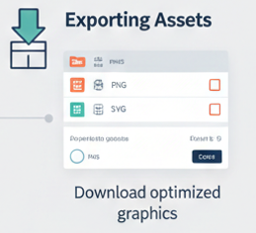
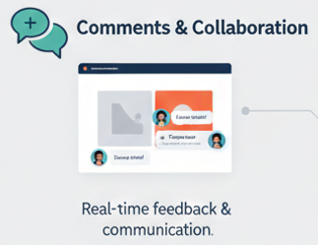
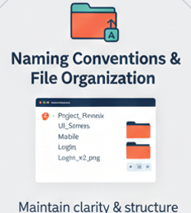
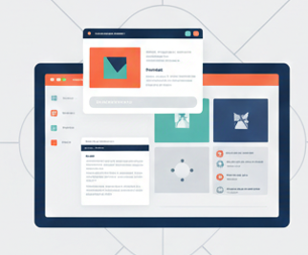
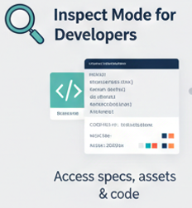
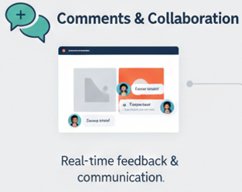
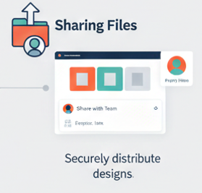
Collaboration, Handoff & Best Practices
Notes:
Best Practices
Use comments instead of verbal feedback (everything stays documented)
Tag teammates using @username
Resolve comments once changes are done
Avoid clutter: don’t leave outdated comments
Importance
✔ Improves team communication ✔ Reduces misunderstandings ✔ Creates a feedback history ✔ Enables remote and real-time collaboration
📌 Real-world example: A developer comments: “Button hover state missing” → designer fixes it → marks comment resolved.
Sharing Files
What it is
Figma files can be shared via links with view, comment, or edit permissions.
Best Practices
Use View-only access for clients
Use Edit access only for core team members
Share specific pages or frames when needed
Lock finished designs to prevent accidental edits
Importance
✔ Maintains design security ✔ Prevents accidental changes ✔ Makes feedback easier ✔ Supports cross-functional teams
Real-world example: Product manager gets comment access, developers get view + inspect access, designers get edit access.
3. Inspect Mode for Developers
What it is
Inspect Mode allows developers to see CSS, iOS, Android properties, spacing, colors, fonts, and measurements directly from the design.
Best Practices
Use consistent Auto Layout
Apply styles (color, text, effects)
Avoid manual spacing; rely on layout rules
Name layers clearly
Importance
✔ Eliminates need for separate design specs ✔ Saves developer time ✔ Reduces implementation errors ✔ Ensures design-to-code accuracy
Real-world example: Developer checks padding, font-size, and color hex code directly, no need to ask designer.
4. Exporting Assets
What it is
Figma allows exporting icons, images, and illustrations in formats like PNG, JPG, SVG, PDF.
Best Practices
Export icons as SVG
Export images at multiple scales (1x, 2x, 3x)
Mark assets clearly for export
Use frames instead of random shapes
Importance
✔ Optimizes performance ✔ Ensures correct asset usage ✔ Prevents blurry or incorrect images ✔ Speeds up development workflow
📌 Real-world example: Mobile app icons exported as SVG → sharper UI on all screen sizes.
5. Naming Conventions & File Organization
What it is
Using meaningful names for files, pages, frames, layers, and components.
Best Practices
Use clear names: Login_Button_Primary
Organize pages:
Research
Wireframes
UI Design
Prototypes
Group related components
Use consistent naming styles (camelCase / snake_case)
Importance
✔ Makes files easy to understand ✔ Helps developers quickly locate elements ✔ Improves team productivity ✔ Essential for large projects
📌 Real-world example: Instead of “Rectangle 124”, name it “Navbar_BG”.

Slide 30
Preparing for Competition
Explaining competition rules
Evaluation criteria

Slide 31
Deliverables:
Minimum 5 screens
Use of:
Components
Auto Layout
Proper typography & color system
Clickable prototype
5-minute presentation per team

